Slide 1
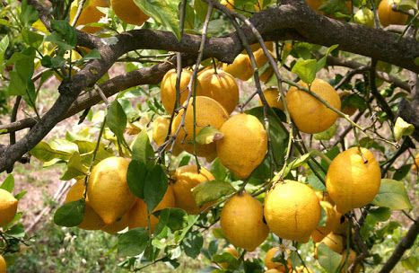
Predict
Predict
Predict

Slide 2
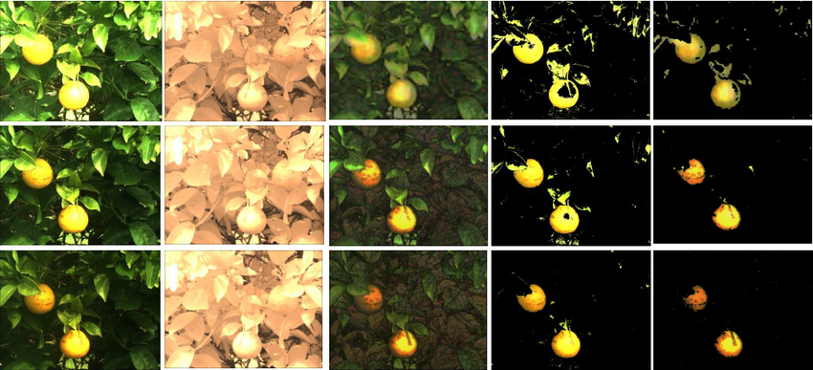
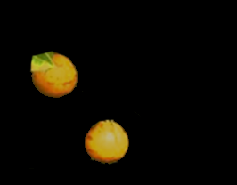
Segmentation Layer
Qualiphal Setup
Original Image
Segmented Image
Detector 1
(D1)
Detector 2
(D2)
Detector 3
(D3)
Cleanup
Engine
Cleaned-up
Image
Input Image
Image
Classifier
Quality
Detection

Slide 3

